Slide 1
Machine Learning for Mechanical Systems Professor: Loris Roveda
LLM-based Process Planning for CNC Machines
09.06.2025 | Bellini, Biraghi, Boccia

Slide 2

Table of Contents
Introduction
Input
API calls
Validation
Post-Processing and G-code
Automatic documentaion
Results
Comments

Slide 3

Introduction
Objective:
Create a Python-based pipeline leveraging Large Language Models (LLMs) to support mechanical process planning for CNC.
What was asked:
Interpretation: Natural-language or basic CAD descriptions of mechanical parts.
Process Planning: Suggest manufacturing steps
Setup Definition: Propose how parts can be fixed and oriented.
Tool Selection: Automatically identify suitable tools for each operation.
Parameter Estimation: Provide realistic machining parameters
Constraints:
Utilize an existing LLM API strictly for inference (no fine-tuning).
Perform sanity checks and validate mechanical feasibility (e.g., max spindle speed, appropriate tool choices).
Clearly structured, human-readable final outputs (structured tables).

Slide 4
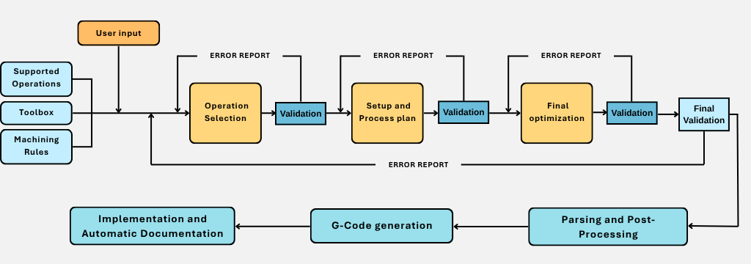
Introduction

Slide 5
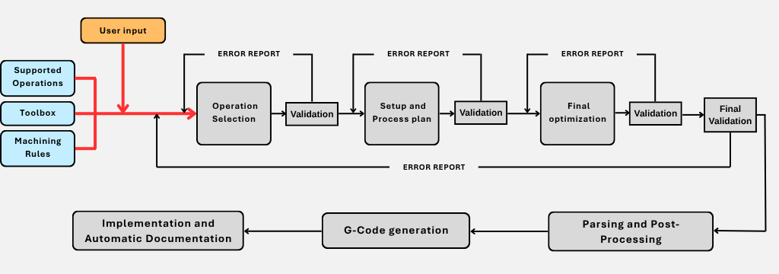
Inputs to the LLM Pipeline

Slide 6
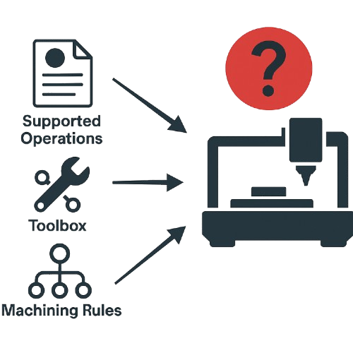
Inputs to the LLM Pipeline – Environment
Defining a structured environment is essential to guide the LLM, reduce errors, and ensure alignment between CNC machine capabilities and the generated output. This foundation enables consistent, realistic, and executable machining plans.
Supported Operations A predefined set of operations is stored, each with technical constraints: ▪ Max RPM, max depth, max tool diameter ▪ Notes for safety, fixturing, or process-specific guidance
Toolbox A digital tool library maps each tool type to available diameters: ▪ Tools like Twist Drill, End Mill, Reamer, etc. ▪ Used to verify compatibility and assign correct T-codes ▪ Enables automatic selection during process planning
Machining Rules Logical rules enforce the correct order of operations: ▪ Rough → Finish sequencing (e.g., Drill before Tap) ▪ Planar logic (e.g., Face Mill before Chamfer) ▪ Additional logic rules to refine specific constraints

Slide 7
Inputs to the LLM Pipeline
The developed pipeline supports three distinct input methods to feed the LLM:
1. Natural Language Text
User provides a simple textual description of the mechanical part.
part_info = (
"You are looking at a rectangular aluminium cover plate for a small gearbox. "
"The finished plate is 120 mm wide (X), 90 mm tall (Y) and 20 mm thick (Z). "
"Its datum is the exact centre of the top face. "
"All edges of the top face are destined for a light-cut 1 mm x 45° chamfer after other machining is complete. "
"The top face needs a 0.8 μm Ra cosmetic finish, so it will be face-milled, as will the bottom face after the part is flipped to reach final thickness. "
"Features, working from the centre outward: "
"• Central bearing seat – one blind hole, pilot-drilled to 10 mm, then bored to 30 mm Ø, 15 mm deep, true position ±0.02 mm, surface finish Ra 0.8 μm. "
"• Alignment dowel hole – one precision reamed hole, 12 mm Ø, 20 mm deep, located 30 mm above the datum on the Y-axis, tolerance H7. "
"• Threaded service port – one blind tapped hole M10 × 1.5, drill Ø 8.5 mm, 18 mm deep, positioned 35 mm below the datum on the Y-axis. "
"• Rectangular relief pocket – 70 mm (X) by 50 mm (Y), 5 mm deep, centred on the datum, corner radii 3 mm. "
"• Oil-feed slot – 60 mm long, 10 mm wide and 10 mm deep, centred on the datum in Y and offset -45 mm in Y, running parallel to the Y-axis. "
"• Four corner mounting holes – through-holes 8 mm Ø, arrayed symmetrically at X ±55 mm, Y ±40 mm; depth equals plate thickness (20 mm).“
)
Example of a textual description

Slide 8
Inputs to the LLM Pipeline
Fill in the following information about the part to be machined:
Material: Aluminium
Select the type of geometry:
1. Plate
2. Cylinder
3. Gear
4. Flange
5. Bracket
6. Block
Enter the corresponding number: 1
Enter the dimensional parameters for geometry: Plate
Length (mm): 100
Width (mm): 200
Thickness (mm): 10
--- GEOMETRIC FEATURE COLLECTION ---
Do you want to add feature #1? (y/n): y
Select the type of feature:
1. Through hole
2. Blind hole
3. Rectangular pocket
4. Circular pocket
5. Slot
6. Chamfer
7. Fillet
8. Hole + Thread
9. Thread
10. Other (free description)
Number corresponding to the feature: 1
2. Structured JSON Dictionary
Created through a guided Python interface.
Dictionary includes structured details (geometry, dimensions, features).
Automatically converted into JSON format to ensure clear interpretation.
User
Input
User friendly Python interface
Automatic
JSON generation
Example of user interface for JSON Dictionary

Slide 9
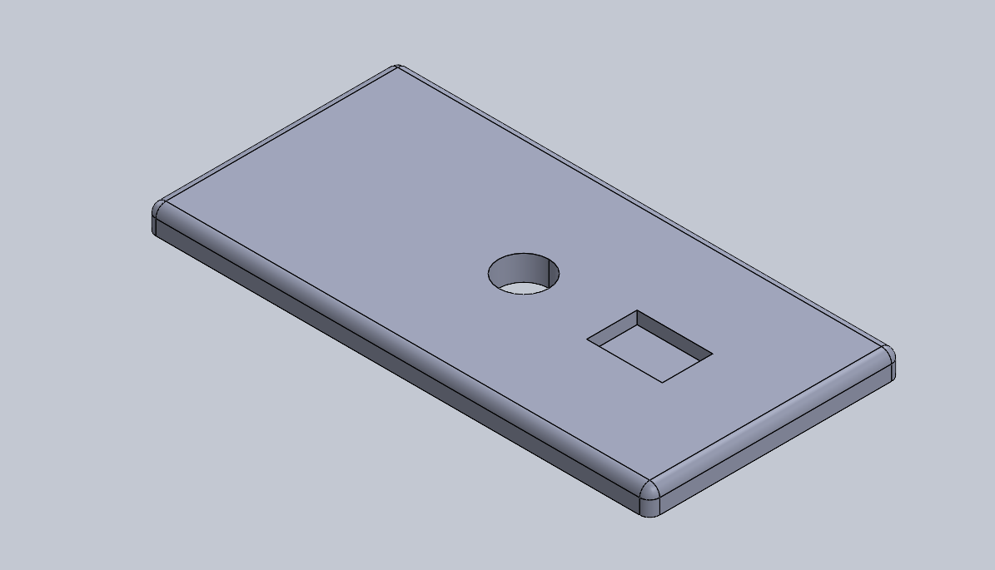
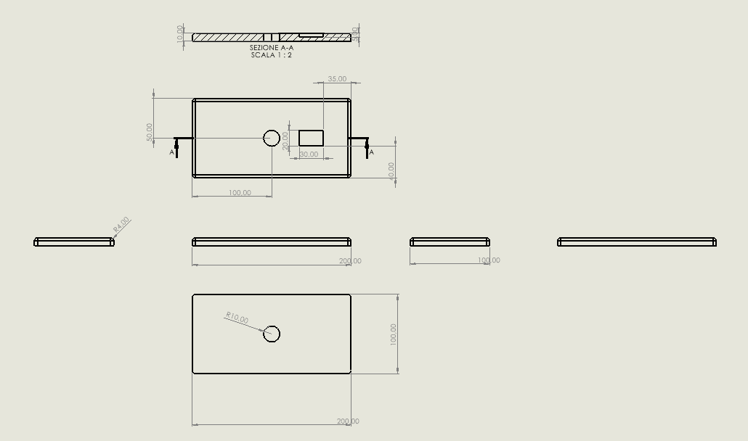
Inputs to the LLM
3. Technical Drawing
The user uploads a file containing orthographic views along with sectional views, these drawings ensure all features of the part are clearly visible and dimensioned.
The file is processed by an LLM, which is tasked with generating a natural language description of the part, using the provided dimensions for accurate geometry interpretation.
Output:
“The part is a rectangular plate with overall dimensions of 200 mm in length, 100 mm in width, and 10 mm in thickness. On the top face, there is a circular through hole with a diameter of 10 mm, centered 50 mm from the left edge and 50 mm from the bottom edge. Adjacent to the circular hole, there is a rectangular pocket with dimensions of 30 mm by 20 mm. This pocket is located 35 mm from the left edge and 20 mm from the bottom edge. The sectional view indicates that this pocket is blind with a depth of 5 mm. The edges of the plate appear to have no additional features such as chamfers or fillets.”

Slide 10
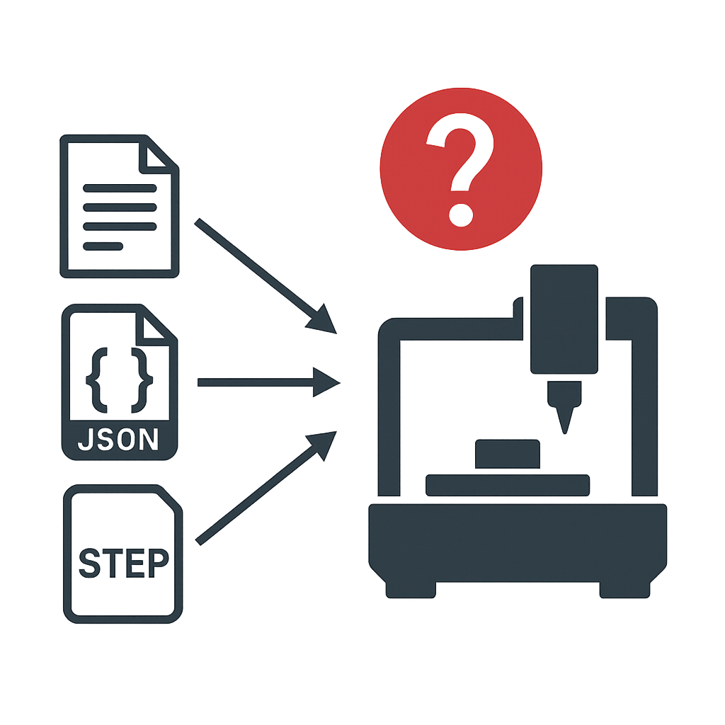
Inputs to the LLM - Challenges and Limitations
1. Natural Language Text:
Must be clear and unambiguous.
Vague or incomplete descriptions can lead to inaccurate interpretations by the LLM.
2. Structured JSON Dictionary:
Currently supports a limited set of predefined geometries and features.
Requires future extension to cover more complex geometries and additional machining features.
3. Technical Drawings
While the LLM correctly captures the overall dimensions of the part, it often introduces small errors in the location of major features.
Minor features such as chamfers and fillets are frequently missed or misinterpreted.
A domain-specific model trained exclusively on technical drawings would likely outperform a general-purpose LLM like GPT-4o in this task.

Slide 11
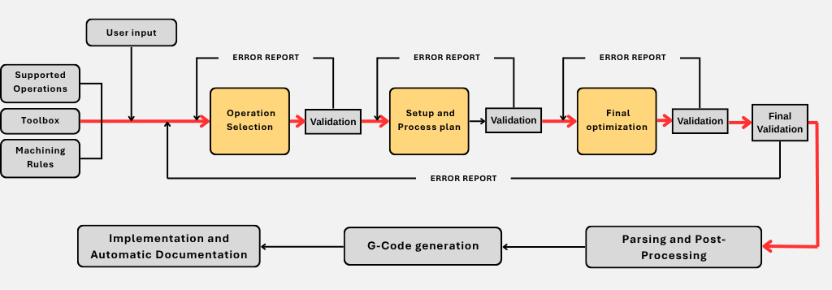
API calls

Slide 12
API calls
The CNC planner uses three structured API calls to define, optimize, and validate operations
Call API:
openai.chat.completions.create(
model=ENGINE,
messages=[{"role": "user", "content": message}],
temperature= temp,
)
Engine: gpt-4o-mini
Selected for its fast, cost-efficient reasoning Ideal for structured CNC workflows.
Each call receives a structured prompt (message) and the temperature (temp) for each task
Machine constraints, tools, and rules are defined to simulate a real CNC setup
CNC Knowledge initialization:
Operations & constraints (max RPM, depth, tool diameter)
Available tools (type and size ranges)
Operation-to-tool mapping
Precedence rules
Five additional calls are made during post-processing to generate detailed G-code and to complete the automatic documentation.

Slide 13
API calls
LLM Call 1 – Operation & Tool selection
Identifies the required machining operations from the part description and assigns a valid tool to each operation, ensuring all machine constraints are respected
system_message1 = (
"You are a CNC expert. Your job is to analyse a part description and identify the required machining operations…
"
)
{
"Operations": [
{
"Operation": "...",
"Tool": "...",
…
}
]
}
Input:
Output:
Part description
Temperature
Available tools, operations
Precedence & formatting rules

Slide 14
API calls
LLM Call 2 – Setup & Process planning
Generates the machining setups and process plan, minimizing total setups and tool changes while ensuring physical feasibility
system_message2 = (
"You are a CNC process planner…
"
)
{
“Setup plan": [
{
…
}
],
“Process plan": [
{
…
}
],
}
Input:
Output:
Part description
Temperature
Call 1 output (Operations & tools)
Machine environment
Setup & process rules
Constraints & formatting rules

Slide 15
API calls
LLM Call 3 – Control & Optimization
Validates the physical feasibility of the process plan and reorders operations to minimize setups and tool changes while ensuring geometric correctness
system_message3 = (
"You are a CNC process validator and final optimiser…
"
)
Input:
Part description
Temperature
Call 1 output (Operations & tools)
Call 2 output (Setup & process plan)
Output:
Final plan

Slide 16
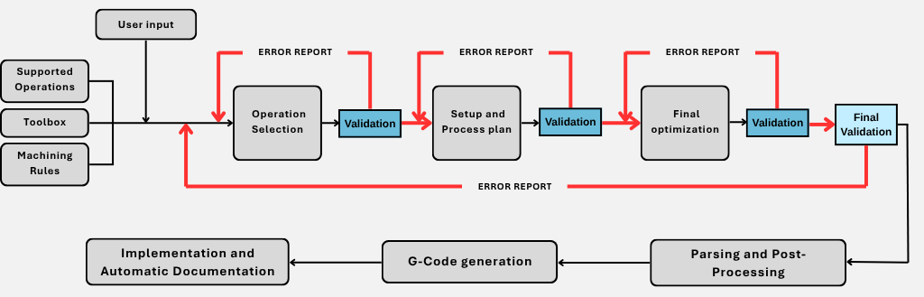
Validation

Slide 17
Validation
CALL 1 - Syntax & Semantic Validation:
Purpose: ☑ Ensure the JSON structure. ☑ Ensure that operations and tools are valid.
Method: Parse the JSON and verify each operation against predefined constraints.
CALL 2 - Parameter & Sequence Validation:
Purpose: ☑ Check the machine constraints. ☑ Ensure that operations follow the correct sequence.
Method: Compare parameters to operation constraints and apply precedence rules.
CALL 3 - Geometric & Setup Validation:
Purpose: ☑ Validate the feasibility of operations concerning setup orientation and spatial constraints.
Method: Analyze positions and orientations to detect possible.
Final Consistency Check:
Purpose: ☑ Verify the presence and structure of all the prescribed sections
Method: Verify that all necessary data structures are present and correctly formatted.

Slide 18
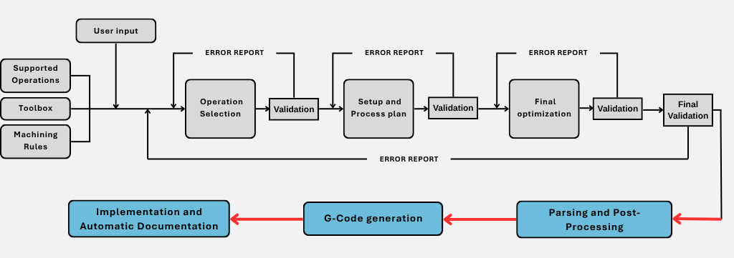
Post-Processing

Slide 19






Parsing and G-code Generation
Parse & Structure Output
Convert the AI-generated text (JSON) into a structured process plan and tabular format.
Parse tool info
Match each tool used in the process plan with its T-code from the machine’s tool table.
Build skeleton G-code
Automatically generate a minimal, deterministic G-code skeleton based on the process plan.
Prompt Construction
Assemble the full machining plan and the skeleton G-code into a single prompt for the LLM.
LLM Expansion
The LLM expands each step into detailed, realistic G-code
Export to File
The final G-code is saved, ready for use on CNC machines or in simulators.

Slide 20
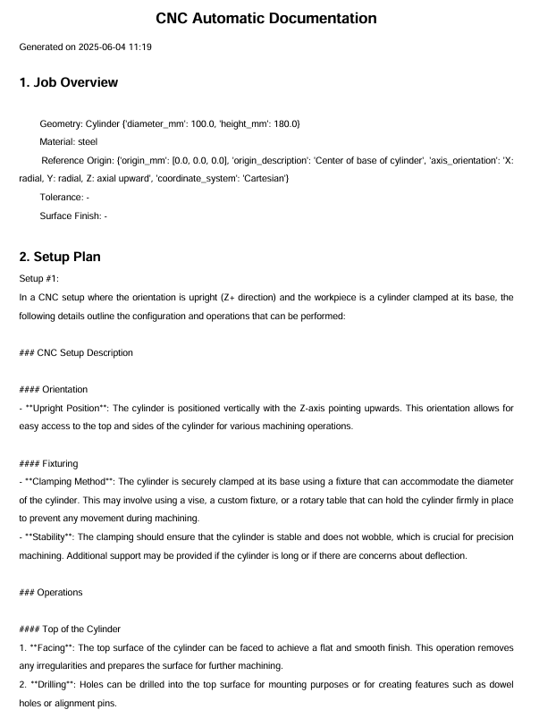
Automatic documentation
The automatic documentation generates a structured CNC documentation PDF, including technical info, setup/process plans, tool list, G-code, safety standards, and maintenance instructions
Document structure:
Job overview
Setup plan
Process plan
Tool list
G-code
Safety & Competency standards
Maintenance procedures
The PDF is enhanced by LLM calls that produce detailed descriptions for setups, steps, safety, and maintenance
Output:
Structured PDF report including geometric data, LLM-generated setup and process plans, tool inventory, G-code, and safety and maintenance sections

Slide 21
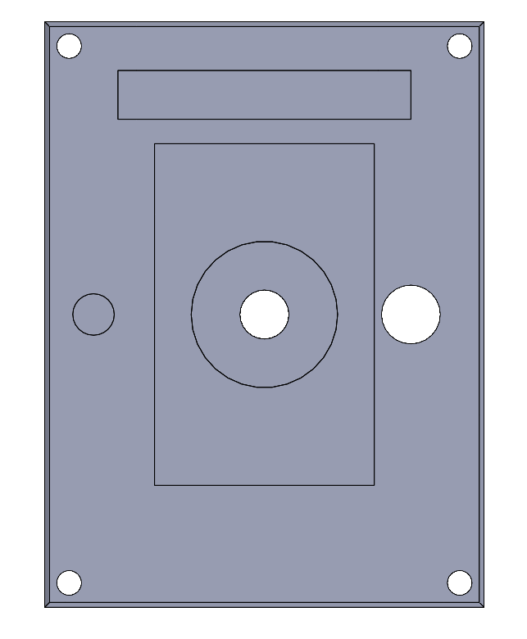
Result – Natural Language
Input:
"You are looking at a rectangular aluminium cover plate for a small gearbox. "
“……..”
"Features: “
“……..”
“Four corner mounting holes – through-holes 8 mm Ø, ……….“
Comments:
The call 3 validation function present a slightly different structure to properly assess this input type.
The purpose here is to draft the setup and process plan, so location values are approximate; the user must confirm them before the work can commence

Slide 22
Result – Natural Language
Type | Setup number | Notes | Step number | Operation | Tool | Position | RPM | Feed | Depth
Setup | 1 | Top Face Up | - | - | - | - | - | - | -
Step | 1 | Cosmetic finish | 1 | Face Milling | Face Mill Cutter, ø 50 | Top Face | 8000 | 100 | 5
Step | 1 | Pilot drilling before boring | 2 | Drilling (Blind Hole) | Twist Drill, ø10 | Central bearing seat | 6000 | 150 | 15
Step | 1 | Boring to achieve true position and surface finish | 3 | Boring | Boring Head, ø 30 | Central bearing seat | 5000 | 50 | 15
Step | 1 | Reaming for H7 tolerance, coolant required | 4 | Reaming | Reamer, ø 12 | Alignment dowel hole | 4000 | 30 | 20
Step | 1 | Drilling before tapping | 5 | Drilling (Blind Hole) | Twist Drill, ø 9 | Threaded service port | 6000 | 150 | 18
Step | 1 | Tapping M10 × 1.5 | 6 | Tapping | Thread Tap, ø 10 | Threaded service port | 2500 | 50 | 18
Step | 1 | Through holes for mounting | 7 | Drilling (Through Hole) | Twist Drill, ø 8 | Corner mounting holes | 6000 | 150 | 20
Step | 1 | Pocket milling for enclosed pocket | 8 | Pocket Milling | End Mill, ø 20 | Rectangular relief pocket | 7500 | 100 | 5
Setup | 2 | Bottom Face Up | - | - | - | - | - | - | -
Step | 2 | Cosmetic finish | 9 | Face Milling | Face Mill Cutter, ø 50 | Bottom Face | 8000 | 100 | 5
Step | 2 | Chamfering all edges | 10 | Chamfering | Chamfer Mill, ø 10 | All edges | 10000 | 200 | 2
Step | 2 | Depth within limit. | 11 | Slot Milling | End Mill, ø 10 | Oil-feed slot | 7000 | 100 | 10

Slide 23
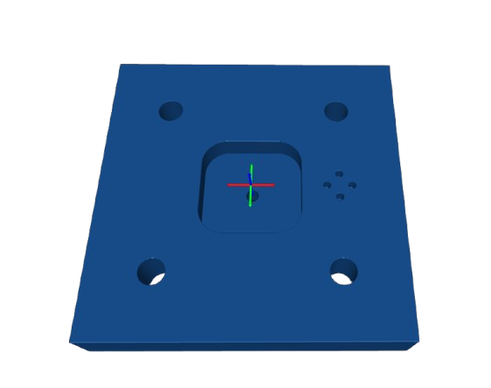
Result – JSON Dictionary
Input:
part_info = {
"geometry": "Plate",
…………..
"features": [
{
"type": "Blind hole",
"diameter_mm": 3.0,
……………… }, ……. ] ,
……}
Comments:
The input must be generated through the Python interface, which can introduce some overhead; a more streamlined interface could easily address this.
The input is straightforward to parse, and the generated process plan can be quickly converted into precise, production-ready G-code.

Slide 24
Result – JSON Dictionary
Type | Setup Number | Notes | Step Number | Operation | Tool | Position | RPM | Feed [mm/min] | Depth [mm]
Setup | 1 | Top face up | - | - | - | - | - | - | -
Step | 1 | Coolant activated for chip evacuation | 1 | Drilling (Blind Hole) | Twist Drill, ø 3 | 35.0, 5.0, 20.0 | 6000 | 100 | 5
Step | 1 | Coolant activated for chip evacuation | 2 | Drilling (Blind Hole) | Twist Drill, ø 3 | 35.0, -5.0, 20.0 | 6000 | 100 | 5
Step | 1 | Coolant activated for chip evacuation. | 3 | Drilling (Blind Hole) | Twist Drill, ø 3 | 30.0, 0.0, 20.0 | 6000 | 100 | 5
Step | 1 | Coolant activated for chip evacuation | 4 | Drilling (Blind Hole) | Twist Drill, ø 3 | 40.0, 5.0, 20.0 | 6000 | 100 | 5
Step | 1 | Single pass within limits | 5 | Drilling (Through Hole) | Twist Drill, ø 10 | 35.0, 35.0, 20.0 | 6000 | 100 | 20
Step | 1 | Single pass within limits | 6 | Drilling (Through Hole) | Twist Drill, ø 10 | 35.0, -35.0, 20.0 | 6000 | 100 | 20
Step | 1 | Single pass within limits | 7 | Drilling (Through Hole) | Twist Drill, ø 10 | -35.0, 35.0, 20.0 | 6000 | 100 | 20
Step | 1 | Single pass within limits | 8 | Drilling (Through Hole) | Twist Drill, ø 10 | -35.0, -35.0, 20.0 | 6000 | 100 | 20
Step | 1 | Single pass within limits | 9 | Drilling (Through Hole) | Twist Drill, ø 5 | 0.0, 0.0, 20.0 | 6000 | 100 | 20
Step | 1 | Coolant activated for chip evacuation | 10 | Pocket Milling | End Mill, ø 20 | 0.0, 0.0, 20.0 | 7500 | 150 | 10

Slide 25
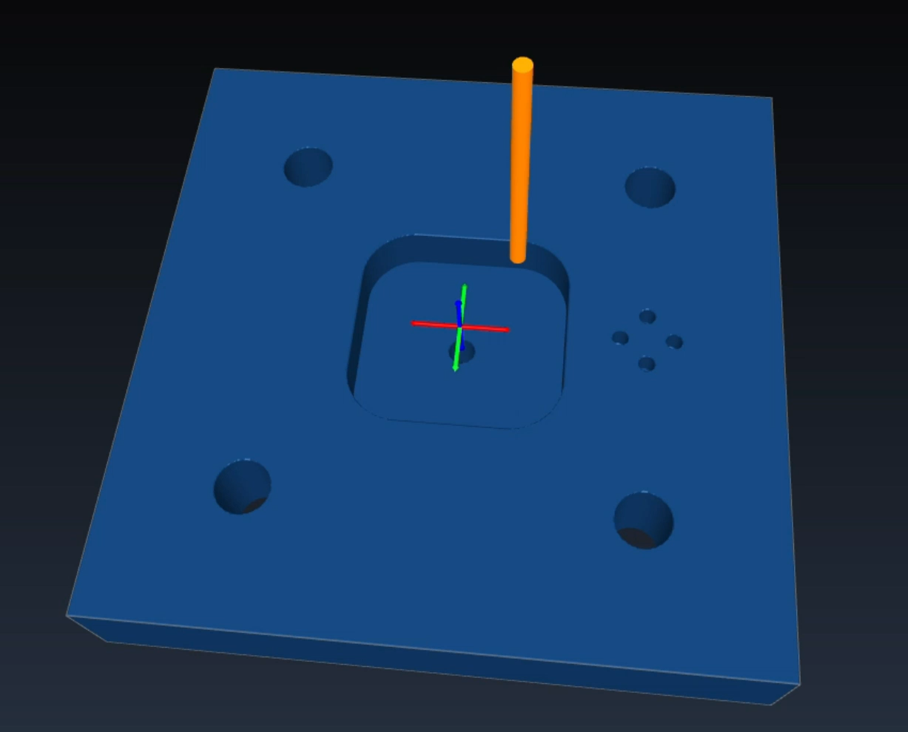
Result – JSON Dictionary
G-Code
(--- Setup 1 ---)
(Orientation: Top face up)
G21 G90 G17
T2 M6 (change to ['twist drill', 3])
(Step 1: Drilling (Blind Hole)
S6000 M3
G0 Z10.
G0 X35.00 Y5.00
M8 (Coolant on)
G1 Z-5.0 F100 (Plunge to depth)
G0 Z10.0 (Retract)
G4 P1 (Pause before next operation)
……..
……..
G21 G90 G17
T44 M6 (change to ['end mill', 20])
(Step 10: Pocket Milling)
S7500 M3
…….
M30
Simulation performed with CAMotics.

Slide 26
Comment
LLM Reliability & Helpfulness
Fast first draft: Quickly generates a process plan from both JSON-structured and free-text descriptions.
Structured-input advantage: With JSON (explicit coordinates), the model is generally consistent and on-spec. In this case, G-code can be generated automatically from the LLM output without user intervention.
Simple features = good: Pocketing, contouring and basic drilling are usually correct.
Context-dependent setups = weak: Struggles with operations that depend on part orientation, e.g. chamfering edges that are blocked by the table.
 | Typical LLM output | Human intervention
Chamfering on all edges | Places every edge in a single setup, ignoring that the lower face is inaccessible. | Split into two setups and re-assign tools.
Multiple holes requested | Generates one composite “Drill 4 holes” op instead of four separate ops. | Duplicate & locate individual drilling cycles.
Complex multi-feature part | Misses at least one feature; position lines in the prompt appear to be “ignored”. | Prompt split in two + manual merge of the plans.

Slide 27
Comment
Root Causes & Additional Observations
Token dilution:
Long prompts force the LLM to prioritise higher-probability tokens; low-salience details (exact positions) get dropped.
No geometric reasoning:
The model lacks awareness of collisions, fixtures, or tool reach → cannot autogenerate alternative setups.
Sequential prompting trade-off:
Splitting prompts improves local accuracy but destroys the global optimisation of toolpaths and setups.
Text vs. numbers:
Free-language location phrases (“10 mm from the left”) are ambiguous; explicit XYZ in JSON works far better.
Post-processing still mandatory:
Even on its best day, the model outputs G-code that needs a 2-minute sanity pass and occasional hand-fixes.
Conclusion:
Valuable as a productivity booster, but not production-ready without checks.

Slide 28
Machine Learning for Mechanical Systems Professor: Loris Roveda
Thanks for your attention
09.06.2025 | Bellini, Biraghi, Boccia

Slide 29
Comments
Type | Setup number | Notes | Step number | Operation | Tool | Position | RPM | Feed | Depth
Setup | 1 | Top face up | - | - | - | - | - | - | -
Step | 1 | Initial face milling to achieve flatness within 0.05 mm over the entire area. | 1 | Face Milling | Face Mill Cutter, ø 50 | Top Face | 8000 | 100 | 5
Step | 1 | Machining the central pocket, single pass within depth limit. | 2 | Pocket Milling | End Mill, ø 10 | Central pocket | 7500 | 100 | 8
Step | 1 | Blind holes for threaded inserts, single pass within depth limit. | 3 | Drilling (Blind Hole) | Twist Drill, ø 10 | Four M12 threaded inserts | 6000 | 50 | 22
Step | 1 | Through holes for dowel pins, single pass within depth limit. | 4 | Drilling (Through Hole) | Twist Drill, ø 6 | Six through-holes for dowel pins | 6000 | 50 | 25
Step | 1 | Shallow pocket for identification recess, within depth limit. | 5 | Pocket Milling | End Mill, ø 10 | Identification recess | 7500 | 100 | 0.5
Step | 1 | Machining cable-pass channels, single pass within depth limit. | 6 | Slot Milling | End Mill, ø 15 | Two cable-pass channels | 7000 | 100 | 6
Setup | 2 | Bottom face up | - | - | - | - | - | - | -
Step | 2 | Counterbore depth of 5 mm, single pass within depth limit. | 7 | Boring | Boring Head, ø 20 | Eight counterbored mounting holes | 5000 | 50 | 5
Step | 2 | Chamfering edges with a 45-degree angle, within depth limit. | 8 | Chamfering | Chamfer Mill, ø10 | Exposed edges | 10000 | 100 | 2

Slide 30
Comments
Type | Setup number | Notes | Step number | Operation | Tool | Position | RPM | Feed | Depth
Setup | 1 | Top Face up | - | - | - | - | - | - | -
Step | 1 | Initial face milling to achieve surface finish. | 1 | Face Milling | Face Mill Cutter, ø 50 | Top Face | 8000 | 100 | 5
Step | 1 | Machining the pocket. | 2 | Pocket Milling | End Mill, ø 10 | Central pocket | 7500 | 80 | 8
Step | 1 | Drilling blind holes for M12 inserts. | 3 | Drilling (Blind Hole) | Twist Drill, ø :10 | Blind holes at X ±65 mm, Y ±65 mm | 6000 | 50 | 22
Step | 1 | Drilling through-holes for dowel pins. | 4 | Drilling (Through Hole) | Twist Drill, ø 6 | Through-holes for dowel pins | 6000 | 50 | 25
Setup | 2 | Flipped, Bottom Face up. | - | - | - | - | - | - | -
Step | 2 | Applying 1.5 mm chamfer around edges. | 5 | Chamfering | Chamfer Mill, ø 10 | Exposed edges | 10000 | 100 | 2
Setup | 1 | Top face up | - | - | - | - | - | - | -
Step | 1 | Pass 1/1, dir: -Z. Shallow depth does not require coolant. | 1 | Pocket Milling | End Mill, ø 20 | Identification recess at X -60 mm, Y +80 mm | 7500 | 200 | 0.5
Step | 1 | Pass 1/1, dir: -Z. Slot depth is within limits. | 2 | Slot Milling | End Mill, ø 15 | Two cable-pass channels at X ±40 mm, running parallel to the Y-axis | 7000 | 150 | 6
Setup | 2 | Bottom face up | - | - | - | - | - | - | -
Step | 2 | Pass 1/1, dir: -Z. Boring head used for counterbore. | 3 | Boring | Boring Head, ø 20 | Counterbore for mounting holes | 5000 | 100 | 5
Step | 2 | Pass 1/1, dir: -Z. Depth is within limits. | 4 | Drilling (Through Hole) | Twist Drill, ø13 | Eight counterbored mounting holes at X -80, -40, +40, +80 mm, Y ±75 mm | 6000 | 100 | 5

Slide 31
Comments
Type | Setup number | Notes | Step number | Operation | Tool | Position | RPM | Feed | Depth
Setup | 1 | Top Face up | - | - | - | - | - | - | -
Step | 1 | Initial face milling to achieve surface finish. | 1 | Face Milling | Face Mill Cutter, ø 50 | Top Face | 8000 | 100 | 5
Step | 1 | Machining the pocket. | 2 | Pocket Milling | End Mill, ø 10 | Central pocket | 7500 | 80 | 8
Step | 1 | Drilling blind holes for M12 inserts. | 3 | Drilling (Blind Hole) | Twist Drill, ø :10 | Blind holes at X ±65 mm, Y ±65 mm | 6000 | 50 | 22
Step | 1 | Drilling through-holes for dowel pins. | 4 | Drilling (Through Hole) | Twist Drill, ø 6 | Through-holes for dowel pins | 6000 | 50 | 25
Setup | 2 | Flipped, Bottom Face up. | - | - | - | - | - | - | -
Step | 2 | Applying 1.5 mm chamfer around edges. | 5 | Chamfering | Chamfer Mill, ø 10 | Exposed edges | 10000 | 100 | 2
Setup | 1 | Top face up | - | - | - | - | - | - | -
Step | 1 | Pass 1/1, dir: -Z. Shallow depth does not require coolant. | 1 | Pocket Milling | End Mill, ø 20 | Identification recess at X -60 mm, Y +80 mm | 7500 | 200 | 0.5
Step | 1 | Pass 1/1, dir: -Z. Slot depth is within limits. | 2 | Slot Milling | End Mill, ø 15 | Two cable-pass channels at X ±40 mm, running parallel to the Y-axis | 7000 | 150 | 6
Setup | 2 | Bottom face up | - | - | - | - | - | - | -
Step | 2 | Pass 1/1, dir: -Z. Boring head used for counterbore. | 3 | Boring | Boring Head, ø 20 | Counterbore for mounting holes | 5000 | 100 | 5
Step | 2 | Pass 1/1, dir: -Z. Depth is within limits. | 4 | Drilling (Through Hole) | Twist Drill, ø13 | Eight counterbored mounting holes at X -80, -40, +40, +80 mm, Y ±75 mm | 6000 | 100 | 5

